Slide 1

DEPARTMENT OF INFORMATION SCIENCE & ENGINEERING
BLOCKCHAIN ARCHITECTURE DESIGN AND USE CASE (18IS7F2)
7th Semester BE
FAKE PRODUCT IDENTIFICATION SYSTEM USING
BLOCKCHAIN TECHNOLOGY
Evaluation- Phase-1
Academic Year – 2023-24
Carried Out By:
Abhishek R(1RV21IS400)
Faculty Incharge :
Sharadadevi K ,Assistant Professor ,Dept. Of ISE,RVCE

Slide 2

Introduction
The Fake Product Identification System employs smart contracts to automate verification processes, enhancing efficiency and reducing human errors. This cutting-edge approach not only safeguards consumers from purchasing fake products but also provides manufacturers with a robust tool to protect their brand integrity. Through the decentralized nature of blockchain, information regarding a product's origin, production, and distribution can be securely recorded and accessed by authorized stakeholders. This system holds the potential to revolutionize supply chain management, fostering a more transparent and accountable ecosystem. As industries grapple with the persistent challenge of counterfeiting, the integration of blockchain technology in the Fake Product Identification System marks a significant stride toward a more secure and trustworthy marketplace.

Slide 3
Topic Relevance
Supply Chain Integrity: Addressing the relevance of a Fake Product Identification System using blockchain technology emphasizes the need to secure and maintain the integrity of supply chains against counterfeit products.
Consumer Protection: Blockchain ensures a transparent and tamper-resistant system, contributing to the protection of consumers by enabling them to verify the authenticity of products before purchase.
Brand Integrity: The topic is relevant for industries aiming to safeguard their brand reputation by implementing a robust system that prevents counterfeit goods from entering the market.
Technology as a Solution: Discussing the relevance highlights the role of blockchain technology as an innovative and effective solution to counter the challenges posed by counterfeit products in various industries.
Transparency and Accountability: The use of blockchain ensures a transparent and traceable system, fostering accountability throughout the production and distribution processes, which is vital for combating counterfeiting.
Efficiency through Automation: The integration of smart contracts streamlines verification processes, enhancing efficiency and reducing the risk of errors in identifying fake products.
Global Impact: The topic is relevant on a global scale, as counterfeiting is a pervasive issue affecting economies worldwide, making the implementation of blockchain-based identification systems a universally significant solution.

Slide 4
Objectives
The objectives are as follows:
Establish a tamper-resistant and transparent system using blockchain technology to secure every stage of the supply chain.
Enable consumers to verify the authenticity of products, ensuring they are not misled or exposed to potentially harmful counterfeit goods.
Safeguard the reputation and trustworthiness of brands by implementing a robust system that deters counterfeiting and protects against brand dilution.
Enhance efficiency by automating the verification processes through the integration of smart contracts, ensuring quicker and more reliable product authentication.

Slide 5





Technology used
Solidity
Javascript
CSS
HTML
Metamask
Ganache
truffle

Slide 6
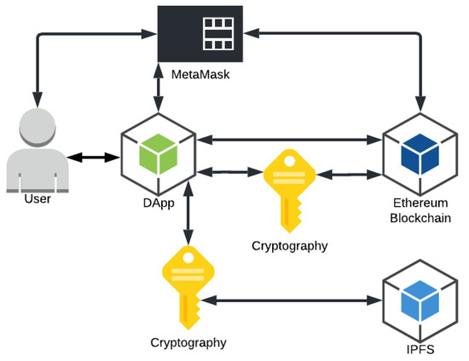
Architecture

Slide 7
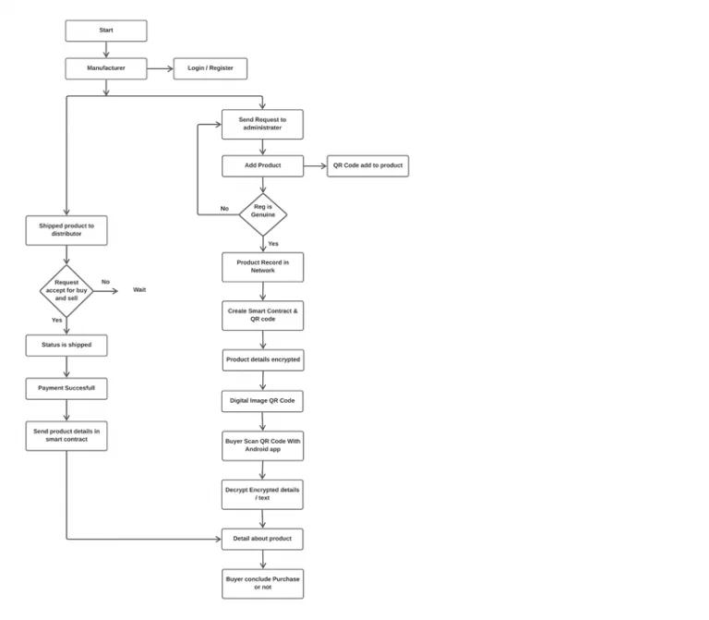

Slide 8
References
[1] Si Chen, Rui Shi, Ren, Jiaqi Yan, Yani Shi, “A Blockchain-based Supply Chain Quality Management Framework”, 14th, IEEE International Conference on e-Business Engineering, 2017.
[2] Blockchain Based Fake Product Identification in Supply Chain www.irjet.net: Ajay Funde, Pranjal Nahar, Ashwini Khilari.
[3] Fake News Detection In Social Media using Blockchain: - Shovon Paul, Jubair Joy, Shaila Sarkar.
[4] A Blockchain-Based Application System for Product Anti-Counterfeiting (IEEE Access): Jinhua Ma, Xin Chen, hung-Min Sun.

Slide 9


